Slide 1
Evolution of Interoperation App
Uiling

Slide 2
Version_0
Functional Requirement:
Can scan valid gateways in private subnet.
Application try all IPs in private subnet, send and receive the response from valid gateways.
Can show the scanned gateway’s sensor information.
Can refresh the sensor information every few seconds.
Can refresh the sensor information by user.

Slide 3
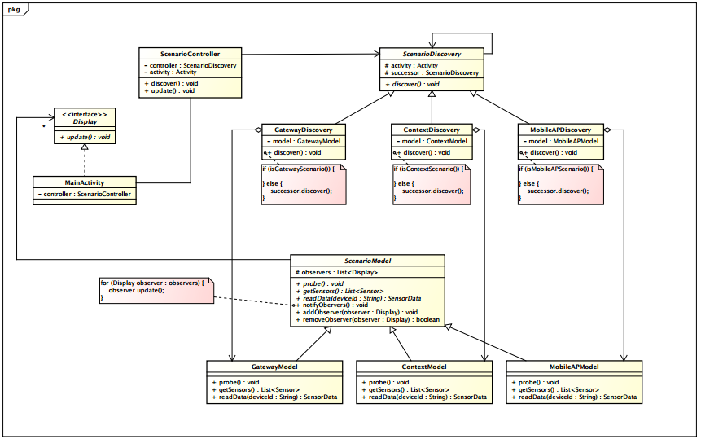
Design

Slide 4
Version_0.0
Functional Requirement:
Can scan valid gateways in public subnet.
Broadcast
Can display all scanned gateways on screen for choosing.
Can display specific gateway’s sensor information.
Can refresh the sensor information every few seconds. All the sensor information will be updated concurrently.
Can refresh the sensor information manually.
Non-Functional Requirement:
Speed up gateway scanning.
Broadcast
Reduce gateway’s responsibility of handling web service.
Socket Programming
There may be more connections between App and gateway.
Reactor Pattern
There may be more type of connections between App and gateway
Connector Pattern

Slide 5
Discovery Module
Gateway Discovery can discover the valid gateway through broadcasting to public network.

Slide 6
Model Module
Gateway Model initiates corresponding Connectors and Service Handlers.
Gateway Model can get sensors’ list through Sensor Operation Handler’s methods.
Gateway Model can read sensors’ data through Sensor Operation Handler’s methods.
Gateway Model can save sensors’ data.
Gateway Model can add observers which will update and display the data .

Slide 7
Controller Module
Scenario Controller controls main process of this application. The main process including below:
Discovery
Discovery Task is an asynchronous task extends from Android library. It discover the gateway through Gateway Discovery methods in the background. And inform the update task to do the update things.
Update
Update task is a timer task extends from Android library. It updates sensors’ data in Gateway Model and notifies UI to refresh in every specified time. It sends update message to UI thread through Scenario Controller’s method.
Controller Module will execute periodically for detecting other gateways .

Slide 8
Encountering Problem
There is no just one connection to be established between mobiles and gateways. How to establish asynchronous connections?
Solution : Reactor Pattern
There is no just one type of connection between mobiles and gateways(ex: TCP,UDP).
Solution : Connecter Pattern

Slide 9
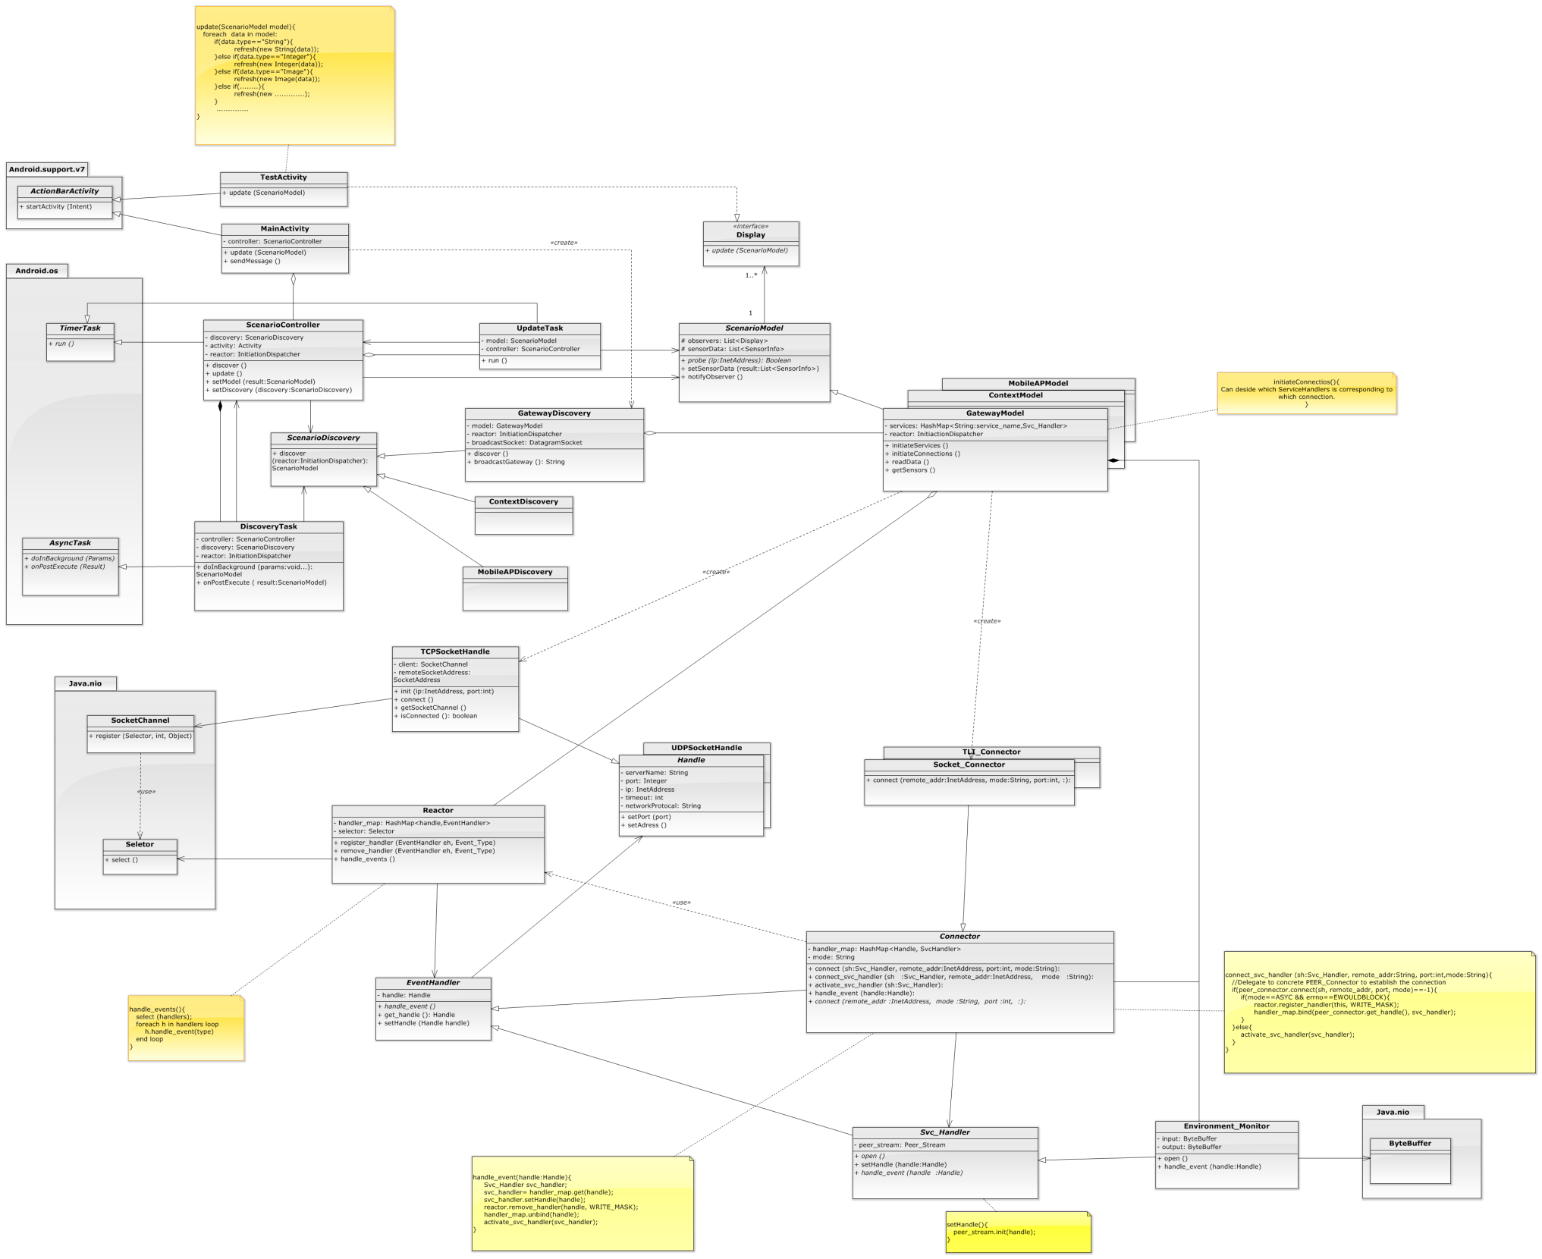
Redesign

Slide 10
Version_0.1
Can scan the valid gateways everywhere.
Can display the sensor information and manipulate the actuators(Smart Plug, IP camera) connected to the valid gateways.
Decoupling the UI Images with mobile app.
Reduce memory usage of connection maintenance.
User friendly data update.

